Slide 1

MTA Ridership Recovery
A Power BI Recovery Analytics Project
Omar Gaber
Ahmed Mamdouh

Slide 2



Project Overview
Why This Analysis Matters
This project addresses the critical need for clear insights into the MTA's post-pandemic operational recovery. By transforming raw, unusable ridership data into an interactive Power BI dashboard, we unlocked key trends across all transit modes. The result is a powerful business intelligence tool that provides stakeholders with the visibility needed for strategic planning.
The Challenge
Lack of visibilityfrom complex, unnormalized data.
The Solution
An end-to-end BI dashboard built with Power BI.
The Impact
Clear, actionable insights on recovery patterns.
G

Slide 3
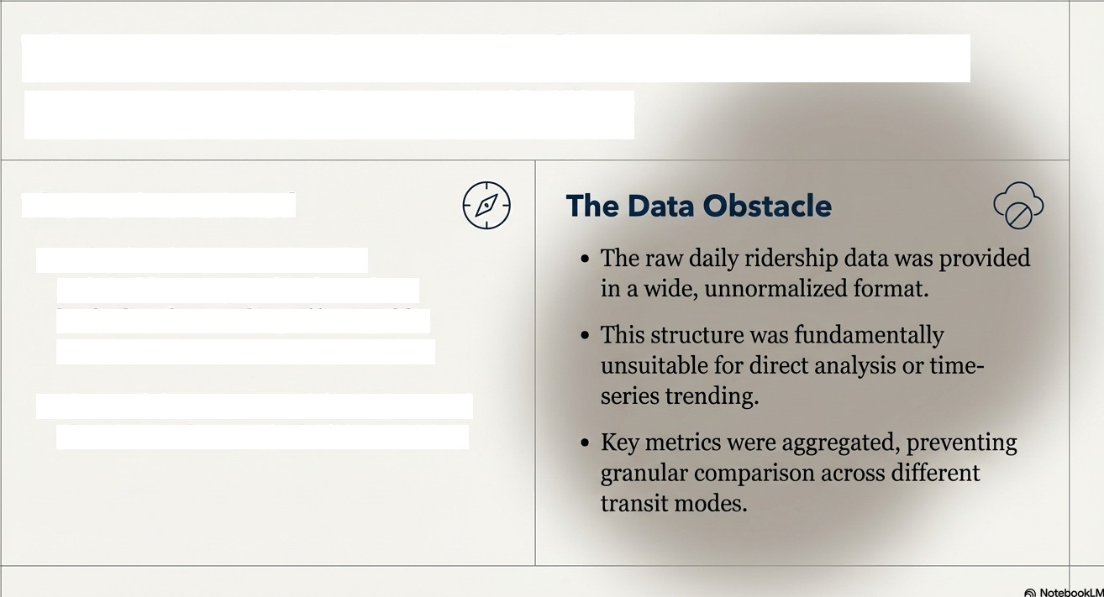
The Challenge
Post-Pandemic Uncertainty
The Business Need
Following the pandemic, MTA stakeholders required a clear, data- backed understanding of how public transportation usage was recovering.
This visibility was crucial for operational planning and strategic decision-making.

Slide 4


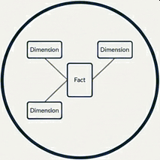

Our Approach
From Raw Data to Clear Insights
Data Ingestion: | ETL Transformation: | Data Modeling: | Visualization:
Raw ridership data | Clean, pivot, and | Build a robust Star | Design an intuitive
from Excel. | shape data using Power Query (M). | Schema for flexible analysis. | dashboard with DAX measures in Power BI.

Slide 5

Understanding the Data
Making Sense of the Numbers
Long/Normalized Data
The primary goal was to convert the wide data format into a long, normalized structure suitable for a relational model.
Wide/Unnormalized Data
Key Transformation Steps
Unpivot Data: Transformed dozens of date-based columns into two rows: Date’ and ’Value’.
Split Composite Fields: Broke down combined columns into distinct “Transportation Mode’ and ’Metric Type’ to enable filtering.
Re-Pivot for Metrics: Pivoted the data to create clean columns for ’Total Ridership’ and Recovery % .
Data Cleansing: Systematically handled null and missing values to ensure data integrity.

Slide 6

Structuring the Information
Building a Clear Data Story
Dim Date
A star schema was implemented to create a clean, eNcient, and highly performant model. This structure separates quantitative data (facts) from descriptive data (dimensions), which is the bedrock of flexible bus- iness intelligence.
(Contains date hierarchies: year, month, day, weekday)
(Contains daily ridership numbers, recovery percentages)
Dim_Transport
(Contains transit modes: Subways, Buses, Rails, etc.)

Slide 7
Key Metrics: How We Measured Recovery
To create a library of robust, reusable measures that provide insight beyond the raw numbers.
Measure Name:
Month-over-Month
Growth •/
Description:
Reveals the recent momentum of ridership recovery.
Measure Name:
Average Recovery %
Measure Name:
Time-Intelligence Calculations
Description:
Enabled powerful period-over- period comparisons (e.g., Same Period Last Year).
business Question
Essential for contextualizing
trends.
Description:
Benchmarks current ridership
against pre-pandemic levels.
/›s›vrring: Are we growing, and howfasti'
/l7S‹›’rr‹n : I-fow close are we to

Slide 8
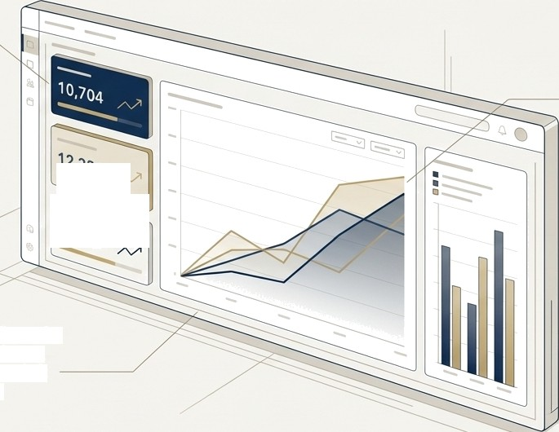





The Dashboard: Visualizing the Recovery Journey
At-a-Glance KPls:
High-level cards provide an immediate summary of the current recovery status.
Trend Visualization: Line and area charts effectively communicate
performance over time and compare recovery across different transit modes.
Z Pattern Layout: The design follows the natural path of the human eye, placing the most important KPIs in the top-left and guiding the user through the narrative.
Professional Palette: A clean, professional color scheme ensures readability and focuses attention on the data.

Slide 9



Insights & Findings:What the Data Revealed
Subways Drive Volume:
Despite varying recovery rates, subways consistently account for the highest absolute ridership, affirming their central role in the city's transit ecosystem.
Vehicular Transit Recovered Fastest:
Bridges & Tunnels consistently outperformed public transit modes,
reaching pre-pandemic levels much more quickly.
Behavioral Ships Are Evident:
A clear distinction in weekend vs. weekday recovery patterns highlights lasting changes in commuting and leisure travel habits post-pandemic.

Slide 10
Impact : How This Helps Decision-Makers
This BI solution moves beyond simple reporting to become a key tool for strategic management. Empowering stakeholders to:
Allocate Resources EKectively
Target Growth
Opportunities
Support Strategic Planning
Make informed decisions based on the nuanced recovery trends and ridership volumes of different transit modes.
Identify which services are lagging in recovery and may require targeted marketing or operational adjustments.
Use reliable, up-to-date data to model future scenarios and inform long-term planning.

Slide 11
Conclusion : What We Achieved
Project Summary
We successfully transformed a complex, unusable dataset into a dynamic and insightful BI dashboard. This tool provides the MTA with critical, ongoing visibility into
post-pandemic ridership recovery.
Value Delivered: The solution replaced ambiguity with clarity, empowering data-driven
decision-making for a vital public service.

